Slide 2
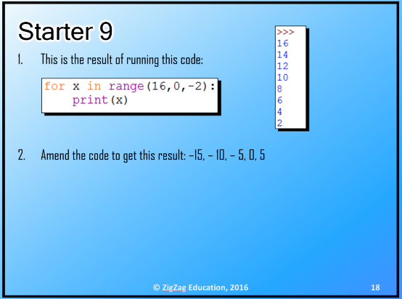
© Pearson Education Ltd 2020. Copying permitted for purchasing institution only.

Slide 3
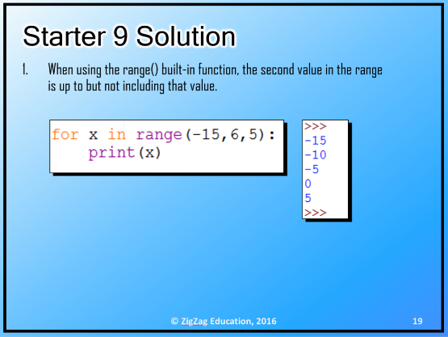
© Pearson Education Ltd 2020. Copying permitted for purchasing institution only.

Slide 4

Learning objectives
In this lesson students will learn to:
  Create functions
  Create procedures
  Use 'separation of concerns’.
For more information on this topic, and additional student activities see Topic 1.7 of the student book.
© Pearson Education Ltd 2020. Copying permitted for purchasing institution only.
Notes:
Specification content: 1.1.1 1.1.2 6.1.1 6.6.1 6.6.2

Slide 5
Subprograms, what’s the point?
Over the last couple of lessons, you’ve learned how to write subprograms in code.
These are useful tools in a programmer’s toolbox and it is best practice to use them whenever you can..
In fact, in industrial code, subprograms make up the vast majority of the code that exists.
But why?
The biggest reason is modularity or ‘separation of concerns’.
Each subprogram has one small job to do.
This makes the development and maintenance of large programs much simpler.
For example, user input is not done in the same function as calculations.
© Pearson Education Ltd 2020. Copying permitted for purchasing institution only.

Slide 6
Subprograms and flowcharts
You’ve looked at how to create flowcharts for many programming structures.
You have used symbols for input and output, selection, and processes, and you can create loops using decisions.
The next step is to incorporate subprograms into your flowcharts.
© Pearson Education Ltd 2020. Copying permitted for purchasing institution only.

Slide 7
Flowchart Example
start
get user’s names
Each of these boxes is a subprogram symbol. You use this symbol when you want to call a subprogram.
We need an algorithm that will generate a username.
For user Robert Jones who joined in June 2019 the username would be:
RobJon0619
Each subprogram would be defined in its own flowchart.
get joining date
convert names
convert date
sub (convert names)
output username
combine name and date
stop
© Pearson Education Ltd 2020. Copying permitted for purchasing institution only.
Notes:
Student Activity 1

Slide 8
Working as a team
Software development is rarely a solo job.
Most software projects have large numbers of programmers working on them. Different programmers will work at different times and on different parts of a project.
This is where ‘separation of concerns’ becomes so useful.
In a computer game for example, you might have a team devoted to the physics engine, and other teams working on the 3D rendering, story, sound design, art, marketing, etc.
The point at which each part of a program interacts with another part is known as an interface.
Remember that subprograms are black boxes – what happens inside them is not visible to the rest of the program.
© Pearson Education Ltd 2020. Copying permitted for purchasing institution only.

Slide 9
Work as a team: group project
You are going to do some software development as a team.
You need to develop a program that can generate a random mix of playing cards and perform some other operations with those cards.
The program will require are at least 4 functions.
Each person in a team will write one function, then the four functions will be inserted into a higher-level program to bring them together.
You will need to use functionality from the Python random library.
Try: random.choice(<list>) or random.randint(0, len(<list>))
© Pearson Education Ltd 2020. Copying permitted for purchasing institution only.
Notes:
Group Activity

Slide 10
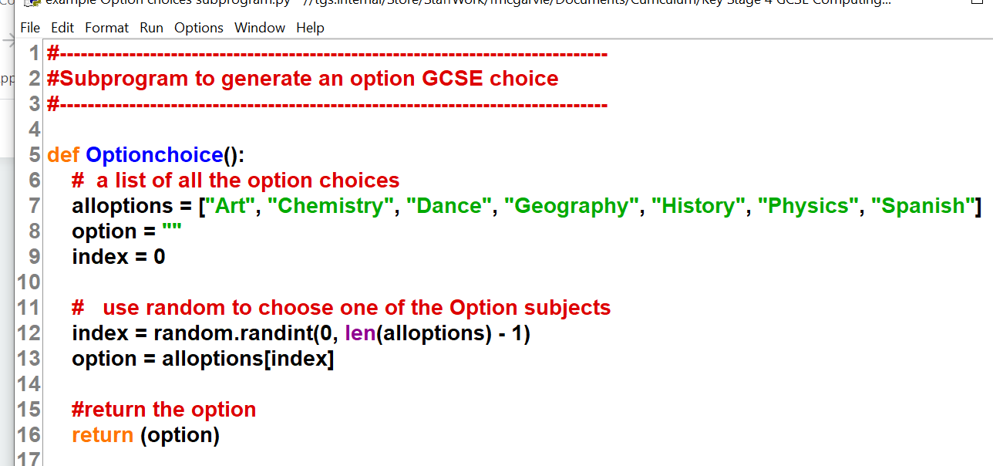
Example subprogram to return a random choice
Comments to explain subprogram below
Name of subprogram
Created a list with all options in it
© Pearson Education Ltd 2020. Copying permitted for purchasing institution only.

Slide 11
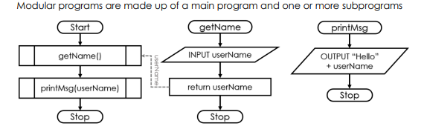
Modular programs – (draw this later on)
© Pearson Education Ltd 2020. Copying permitted for purchasing institution only.

Slide 12

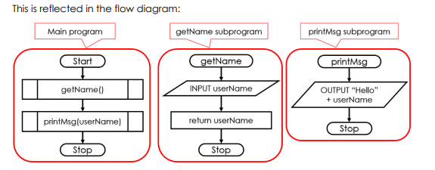
© Pearson Education Ltd 2020. Copying permitted for purchasing institution only.

Slide 13
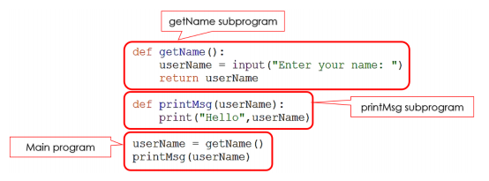
© Pearson Education Ltd 2020. Copying permitted for purchasing institution only.

Slide 14
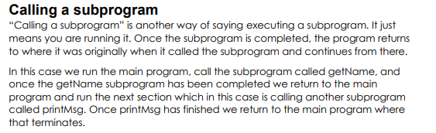
© Pearson Education Ltd 2020. Copying permitted for purchasing institution only.

Slide 15
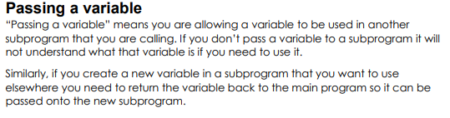
© Pearson Education Ltd 2020. Copying permitted for purchasing institution only.

Slide 16
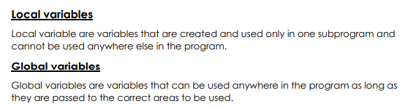
© Pearson Education Ltd 2020. Copying permitted for purchasing institution only.

Slide 17
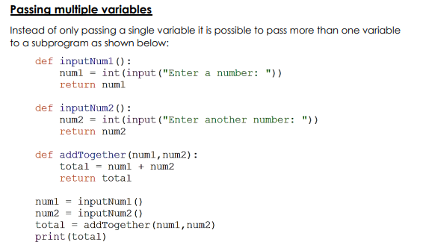
© Pearson Education Ltd 2020. Copying permitted for purchasing institution only.

Slide 18
Sample from the complete program
['Hearts', 'Clubs', 'Hearts', 'Diamonds', 'Clubs']
[1, 3, 9, 12, 5]
----- Current Hand -----
1 of Hearts
3 of Clubs
9 of Hearts
12 of Diamonds
5 of Clubs
© Pearson Education Ltd 2020. Copying permitted for purchasing institution only.

Slide 19
def generateHandSuits(pNumCards):
#initialise an empty list for the hand
#initialse an empty string to hold the suit
hand = [ ] # Holds suits for numCards
theSuit = "" # No suit yet
#use a 'for in range' to loop for pNumCards
for count in range (0, pNumCards):
# call 'generateSuit() to get a suit
# append the suit to the hand
theSuit = generateSuit() # Get one card suit
hand.append (theSuit) # Add it to the hand
# return the hand
return (hand)
© Pearson Education Ltd 2020. Copying permitted for purchasing institution only.

Slide 20
def displayHand (pValues, pSuits):
#write a procedure to display the cards in the hand, like
#you would say it, for example '7 of Hearts'
print ("----- Current Hand -----")
for index in range (0, len(pValues)):
print (str(pValues[index]) + " of " + pSuits[index])
© Pearson Education Ltd 2020. Copying permitted for purchasing institution only.

Slide 21
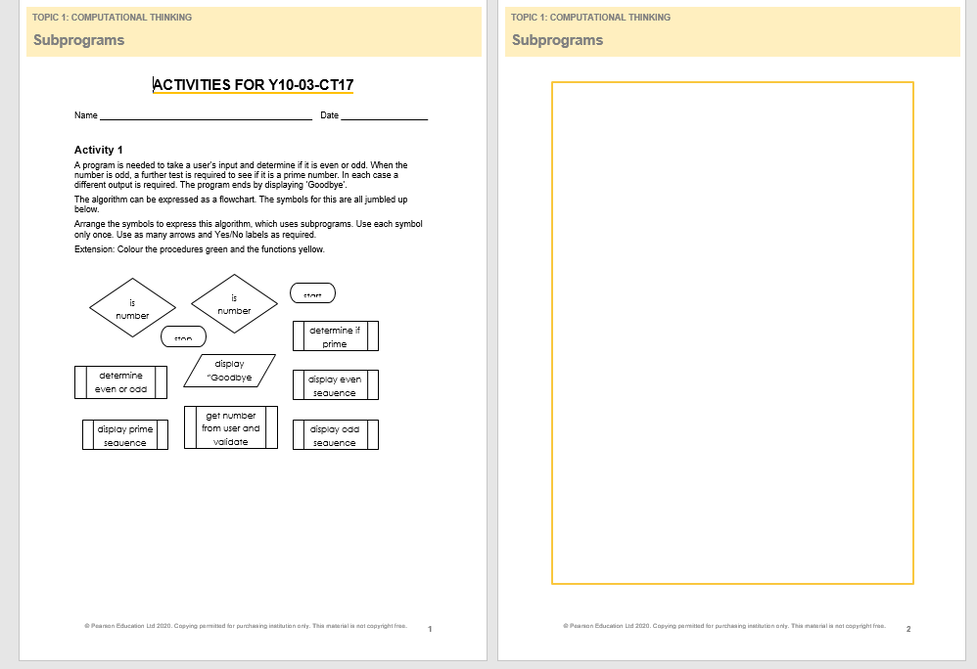
Open up the Activity sheet for this lesson
© Pearson Education Ltd 2020. Copying permitted for purchasing institution only.

Slide 22
Learning objectives
In this lesson students will learn to:
  Create functions
  Create procedures
  Use 'separation of concerns’.
For more information on this topic, and additional student activities see Topic 1.7 of the student book.
Specification content: Tick off on your tracking sheet
6.6.1 6.6.2
© Pearson Education Ltd 2020. Copying permitted for purchasing institution only.
Notes:
Specification content: 1.1.1 1.1.2 6.1.1 6.6.1 6.6.2

Slide 23
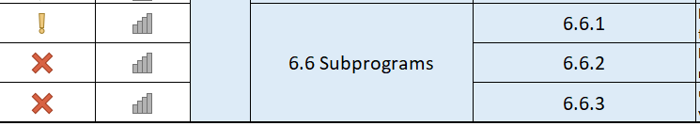
Excel Tracking sheet - Fill both these in as level 1 – partly completed
Fill in as a 1 as not yet completed
Fill in as a low number as we have not finished this
© Pearson Education Ltd 2020. Copying permitted for purchasing institution only.

Slide 24
Wrap up: you have learned how to…
Create functions and procedures.
  You’ve learned how to do both of these in code and in a flowchart.
  Remember that a function returns a value and a procedure does not.
Use 'separation of concerns’.
  Decomposing a large problem down into smaller parts means that more than one person can work on its solution at the same time.
  Subprograms are black boxes, so these parts of a program do not interfere with each other.
© Pearson Education Ltd 2020. Copying permitted for purchasing institution only.

